Slide 1
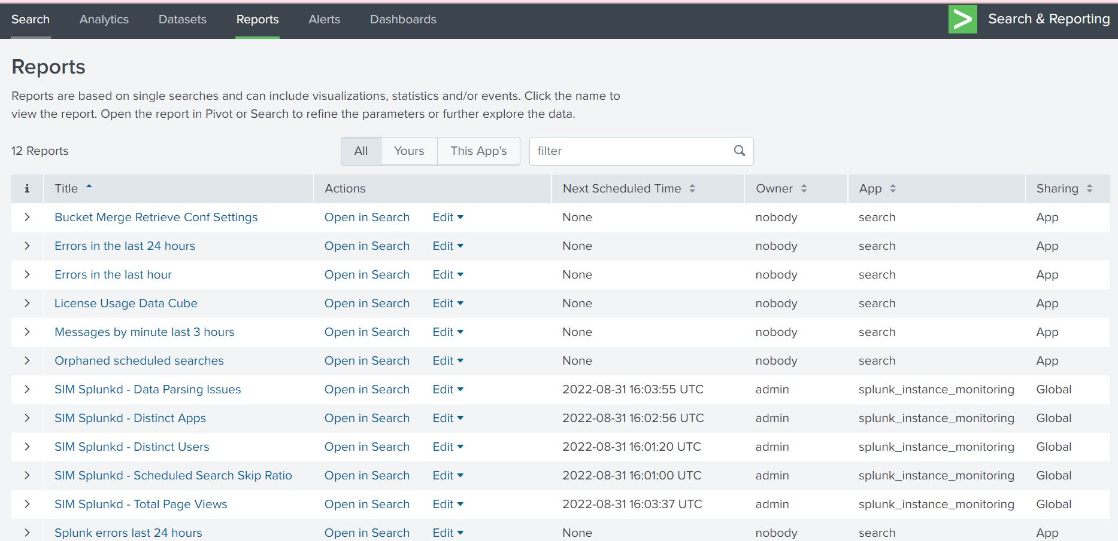
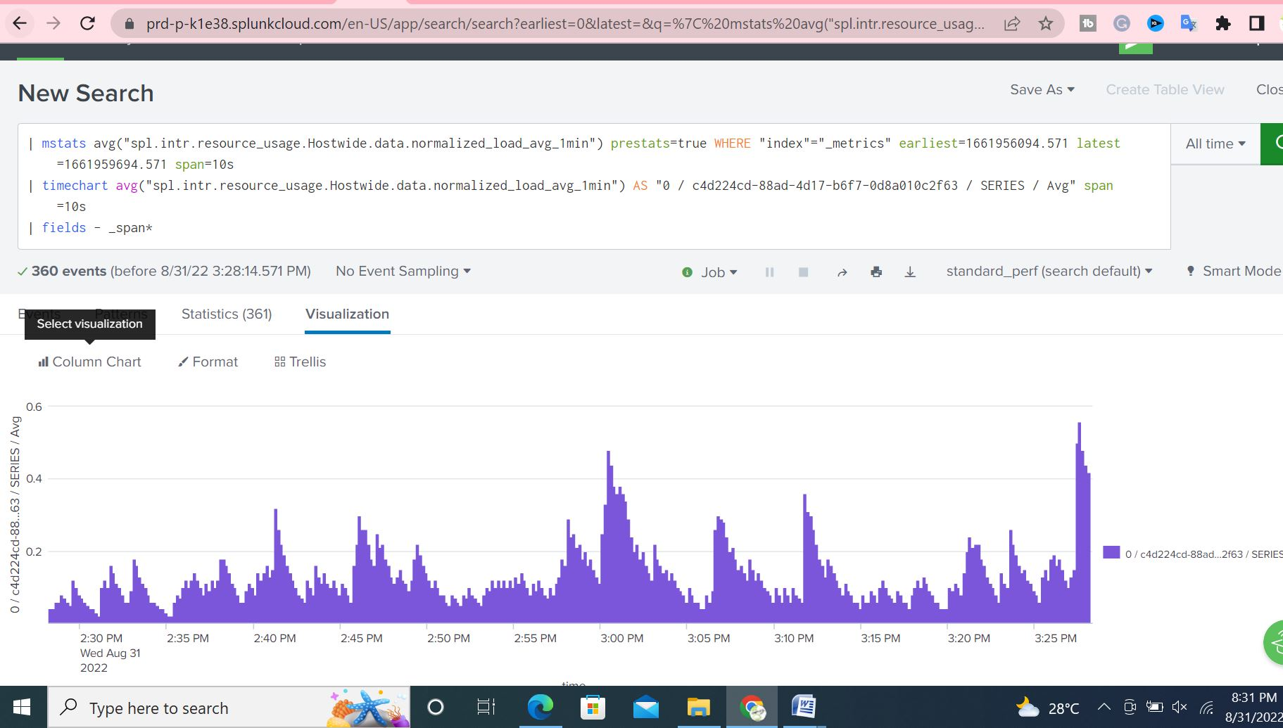
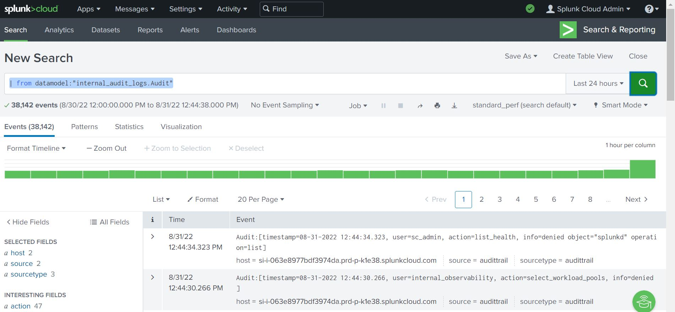
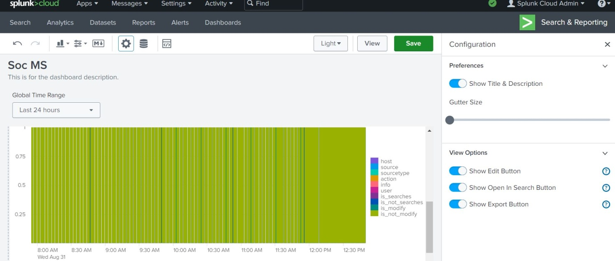
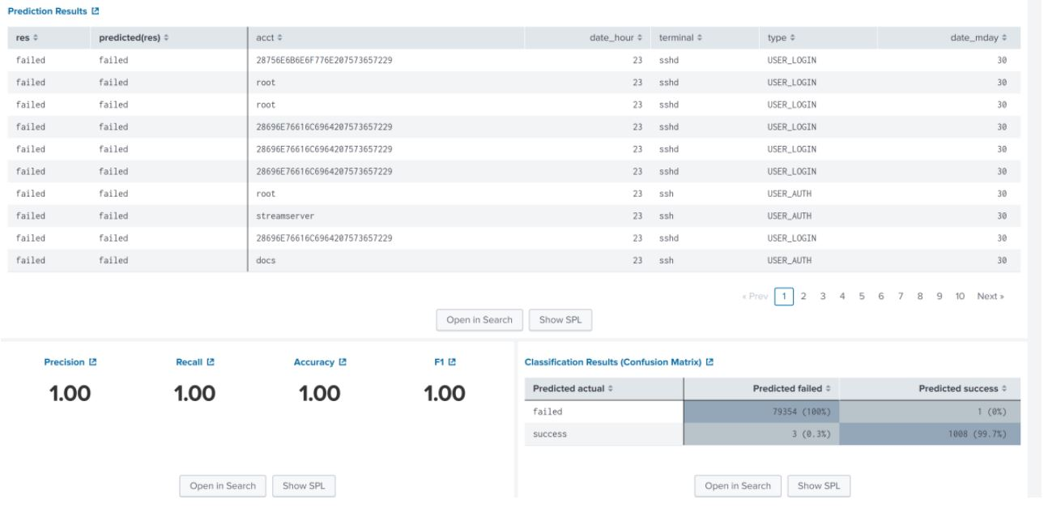
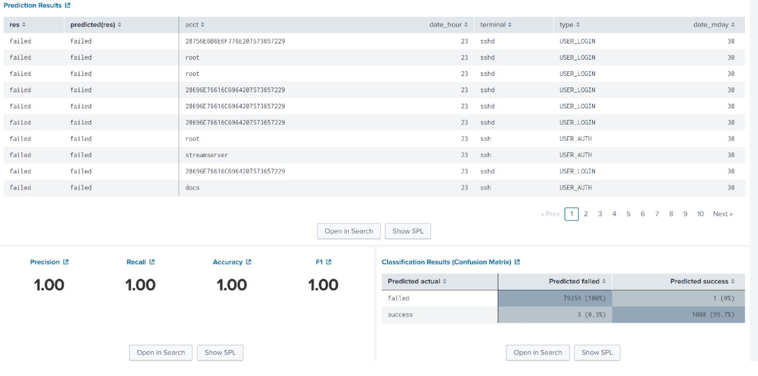
Soc using advanced techniques
SAI BHARADWAJ VALLURUPALLI
, 1831681
MSc Project, Supervisor: name
ABSTRACT
This research describes the fundamental concepts of SOC and the specifics of a practical solution that uses the Splunk tool for real-time cyber threat detection and remediation. We set up the lab on Splunk; Machine Learning Algorithms can detect anomalies from system logs. We were impressed with the accurate predictions of the Splunk machine learning linear regression algorithm.
RESEARCH METHODOLOGY
we discuss the quantitative research strategy thesis adopted to provide organizations with a secure environment by analyzing logs in the security operation center using the Splunk tool.
Static implementation
RESULTS / EVALUATION
DISCUSSION / CONCLUSIONS
In this research, we set up the lab on Splunk; Machine Learning Algorithms can detect anomalies from system logs. We were impressed with the accurate predictions of the Splunk machine learning LR algorithm. Splunk SPL made it easy to create an alert report of the abnormal logins on the forwarded servers.
We were successful in developing automated notifications for failed system attempts. Based on ML linear regression algorithm analysis, we were able to successfully issue notifications of any inappropriate activity and execute an automatic remedy process.
DESIGN / DEVELOPMENT
INTRODUCTION
1.1 Aims
This thesis aims to highlight the problems of thinking like hackers, identifying exploitable flaws in technology, process, and people, or if we are too preoccupied with dealing with billions of logs pushed into SOC. This is the time to begin upgrading our SOC tools with Artificial Intelligence and linear regression-based security technologies to automate and improve our organization's security posture.
1.2 Objectives
Below are a few research project objectives that the suggested technological artefact must meet.
They must examine each record and classify it as hazardous or non-malicious. This task may be simpler by incorporating various tools to speed up the process.
The goal of this study is to use techniques to identify dangers in SOC.
Compare static implementation vs ML implementation using the Splunk tool.
REFERENCES
dmin. (2021). 80-of-soho-routers-contain-vulnerabilities. Retrieved from https://www.infosecurity-magazine.com/news/80-of-soho-routers-contain-vulnerabilities/
admin. (2021). wi-fi-routers-vulnerable-to-default-logins-attack. Retrieved from https://cdn.comparitech.com/wp-content/uploads/2021/07/uSADF-wi-fi-routers-vulnerable-to-default-logins-attack-1.webp
admin. (2022). Retrieved from https://www.kali.org/
admin. (2022). brute-force-attack. Retrieved from https://phoenixnap.com/blog/brute-force-attack
Agarwal, A. K. (2021). Honey Encryption: Fortification Beyond the Brute-Force Impediment. In Advances in Mechanical Engineering, pp. 673-681. Springer, Singapore.
ML model Implementation using Splunk
SCHOOL OF COMPUTER SCIENCE AND TECHNOLOGY

